Slide 1
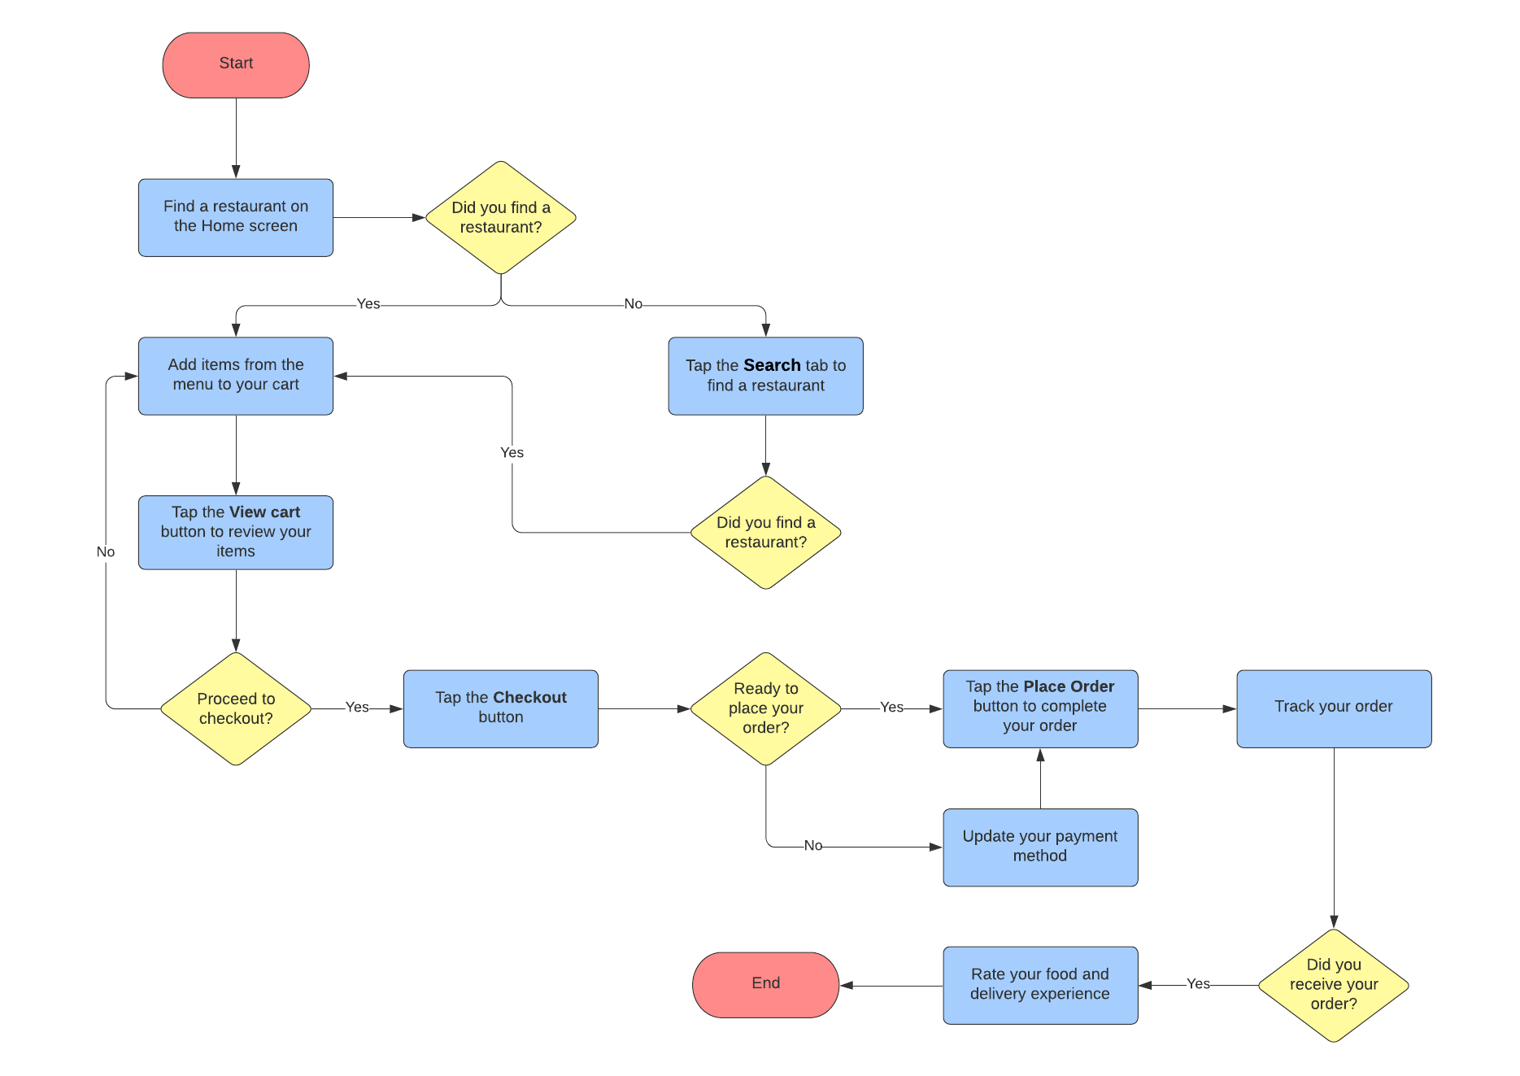
Restaurant website and App
1. Modules
2. Admin
3.users
Modules
Database
User
Search & filter
Integration
Admin
Regression Testing

Slide 2
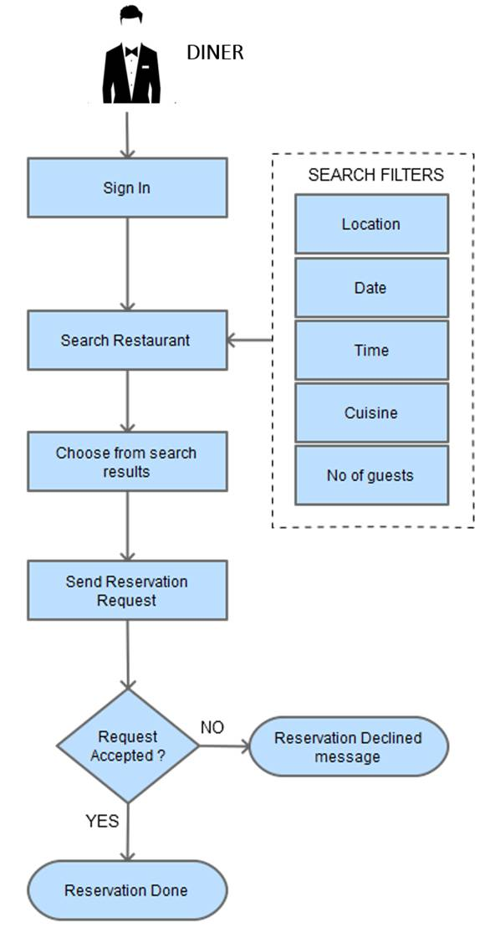
User Portal
Design- (Designing Screens)
Login - ( New user or Existing user)
Location - (search and select location)
Categories - (List , View , Sub Categories)
Items- (View & list item)
Cart- (Add ,delete ,save Product)
Order- (Book, cancel ,order status ,order history)
Payments (make payment online, confirmation)
Search & filter- (Search item ,food etc)
Account- (View ,Edit ,order status ,about contact )
API – (API Development)
Integration- (payment api, google map api, SMS gateway)
Testing- (Testing And debugging)

Slide 3
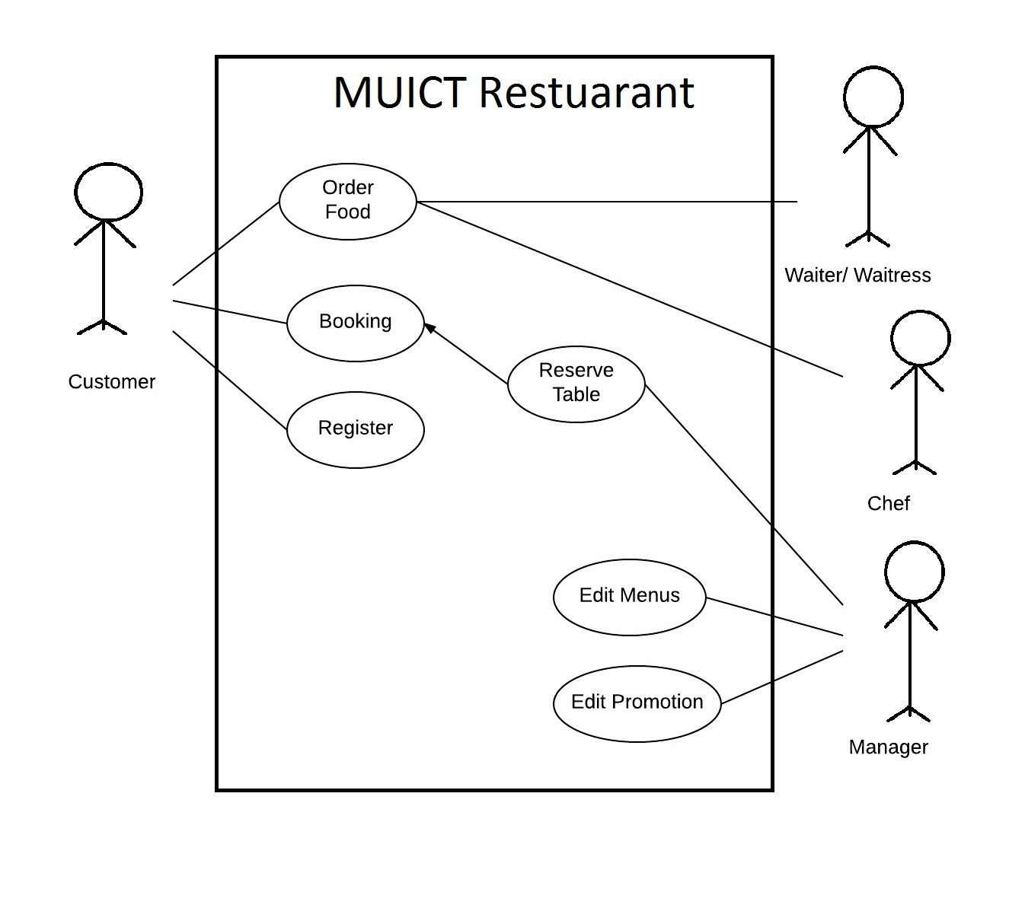
Admin portal
Design- (Designing Screens)
Login - ( New user or Existing user)
*Location - (Add, delete, edit)
*Categories - (Add delete edit Categories)
Items- (View, Add ,edit, delete)
Cart- (Add ,delete ,save Product)
*Order- (Received,)
Payments (Receive payments from users)
Search & filter- (Search item ,food etc)
Account- (View ,Edit ,order status ,about contact )
API – (API Development)
Integration- (payment api, google map api, SMS gateway)
Testing- (Testing And debugging)

